Slide 1
GDPR compliant cloud security
@DNUGBB Meetup Berlin

Slide 2
Who
Sia-Consulting Limited
Software security consulting
Cloud consulting
Software engineering
Trainings
Sia
Software developer and architect
Microsoft Azure MVP
Co-organizing Meetup Hamburg
Frequent speaker and workshop lead at dev conferences

Slide 3


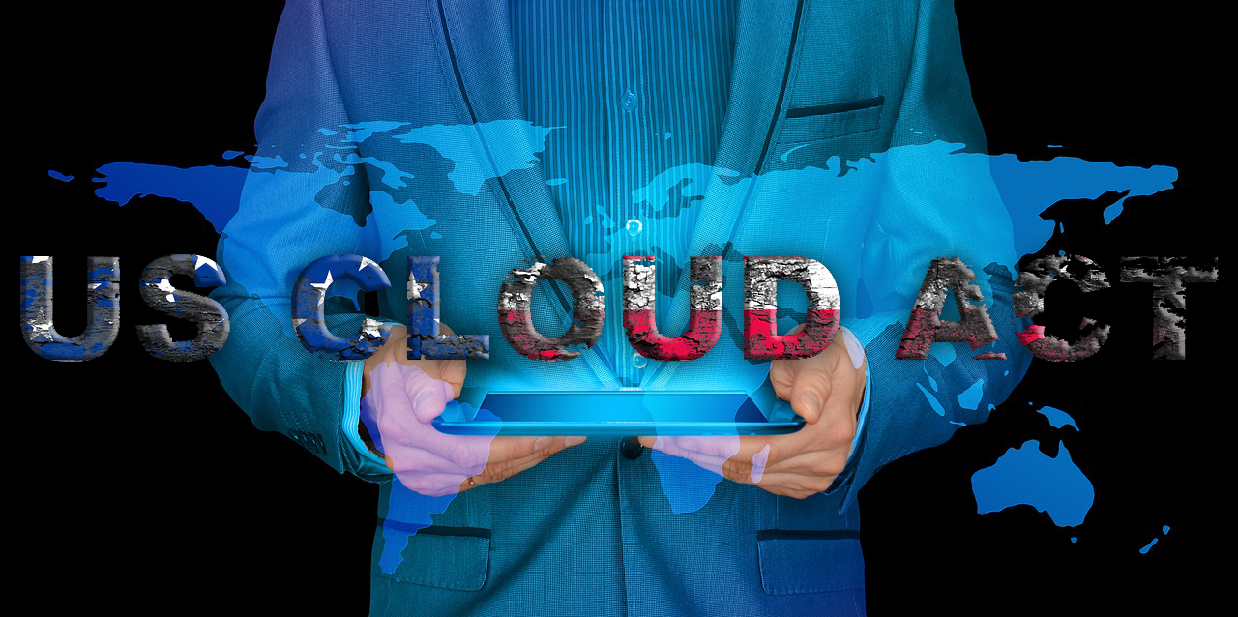

What is this about?
GDPR
EU
CLOUD-Act
USA

Slide 4
Agenda
What is GDPR
What is CLOUD-Act
Technical challenges of GDPR
GDPR vs. CLOUD-Act
The easy way!
Getting started
Event better

Slide 5
What is GDPR
EU General Data Protection Regulation
Approved 2016
Effective since May 25th, 2018
Affects:
All businesses in EU
Non-EU countries, who process data of EU citizens
EU authorities*
Fines up to 20M Euro or 4 % of the worldwide annual corporate revenue

Slide 6

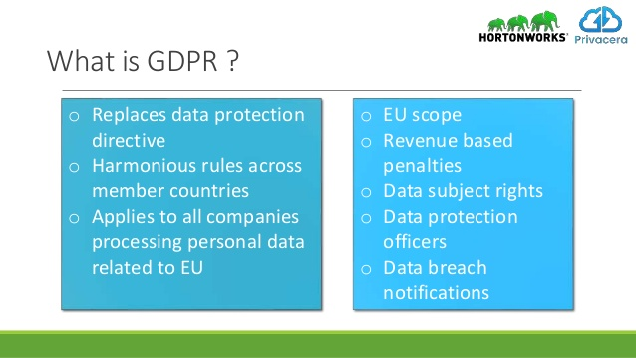



What is GDPR
EU General data protection regulation

Slide 7
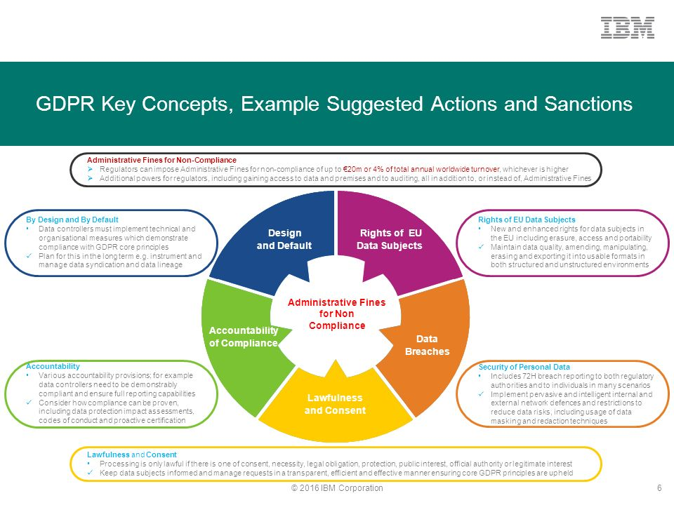

Slide 8
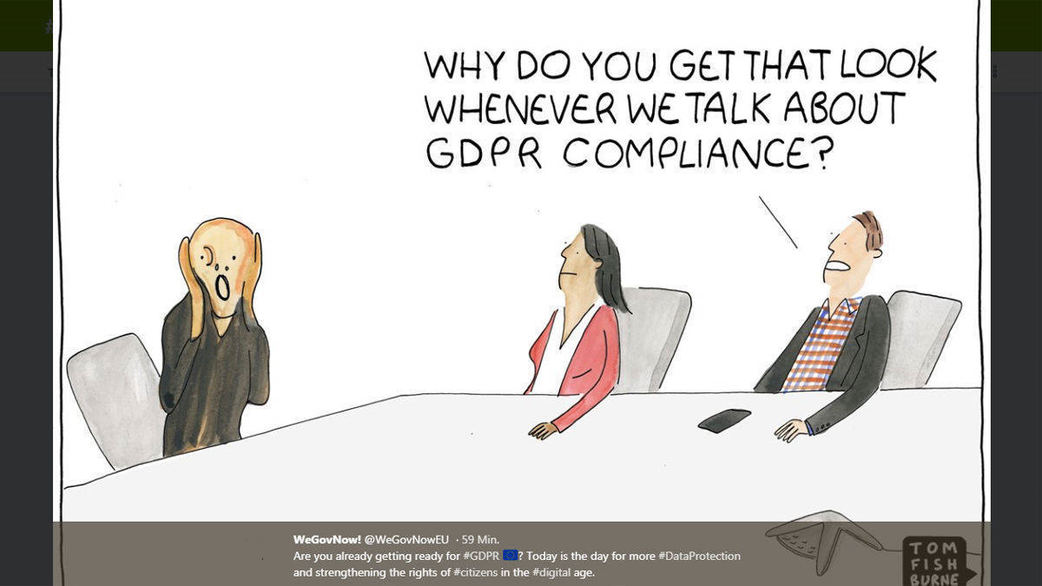
What is GDPR
Privacy by Design
Privacy by Default

Slide 9
GDPR
Transperant information
Article 12
Article 15
Right to erasure (‘right to be forgotten’)
Article 17
Right to data portability
Article 20

Slide 10
GDPR – Transparent information
Article 15:
Everybody has a right to obtain a copy of collected personal data
Article 12:
Provide any information in a „concise, transparent, intelligible and easily accessible form, using clear and plain language, in particular for any information addressed specifically to a child”

Slide 11
GDPR – Transparent information
When did who provide which data and for which purpose?
concise
transparent
intelligible
easily accessible form
using clear and plain language
All business processes must be traceable

Slide 12
GDPR – Right to erasure
Article 17:
The data subject shall have the right to obtain the erasure of personal data concerning him or her without undue delay, as soon as there are no grounds for data storage.
The controller is obligated to erase personal data proactively without undue delay

Slide 13
GDPR – Right to erasure
Personal data (Name, Address etc.)
Personally Identifiable Information (PII)
IP-Address
Documents (invoices, legal documents)
Logs
Backups
As soon as there are no grounds for data storage
Legal grounds (i.e. Invoices must be erased after 10 years, daily check)
Business purpose (i.e. Legal reasons: warranty)

Slide 14
GDPR - Right to data portability
Article 20:
Right to receive the personal data concerning him or her, in a structured, commonly used and machine-readable format and have the right to transmit those data to another controller without hindrance from the controller to which the personal data have been provided

Slide 15
GDPR - Right to data portability
structured
commonly used
machine-readable format
without hindrance
Examples:
Customer wants to move from G-Mail to Outlook.
Customer wants to move from Vonovia to Akelius.

Slide 16
Cloud-ACT
US Clarifying Lawful Overseas Use of Data – Act
Authorizes U.S. law enforcement to unilaterally demand access to data stored even if stored outside the U.S
Needs executive agreements with foreign governments
Disclosure to person of interest can be prohibited
U.S. law enforcement can demand access to data on servers owned by EU businesses! (if an executive agreement with the foreign government exists)

Slide 17
Technical challenges of GDPR
Transparent information
Very detailed auditing needed
Additional metadata needed

Slide 18
Technical challenges of GDPR
Right to erasure
Log-Files can contain IP-Addresss
Backups can contain personal data
Transaction-Log
Proactively delete documents as soon as no more needed
Immutability (block chain)
Non personal data and personal data within same table / forgein-key-contraints
No more deleted flag, once deleted, it‘s gone!
Reports could be less accurate, because data was deleted

Slide 19
Technical challenges of GDPR
Right to data portability
There is no commonly used data format
Everyone has a different data model and data formats
Exports must be importable for others (without hindrance)

Slide 20
GDPR vs. CLOUD-Act
GDPR
All use of personal data must be reported
CLOUD-Act
Law enforcement can prohibit disclosure

Slide 21

Break

Slide 22
The easy way!
Challanges to solve:
Transparent information
Right to data portability
Right to erasure

Slide 23
Event Sourcing
Described by Martin Fowler in 2005
Data is stored as a stream of events
Events are immutable (at least without time machine)
Events are stored in the order they arrive
New events are always appended to the end of the stream
Current state is achieved by replaying all events through a state machine

Slide 24
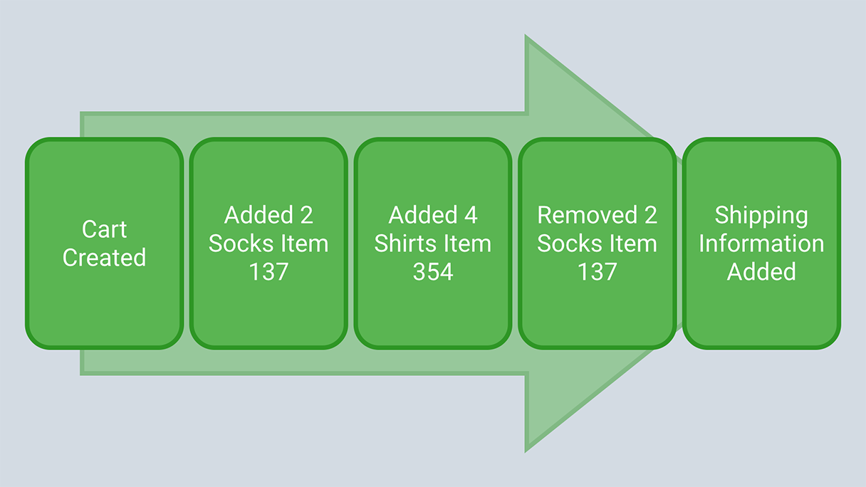
Event Sourcing

Slide 25
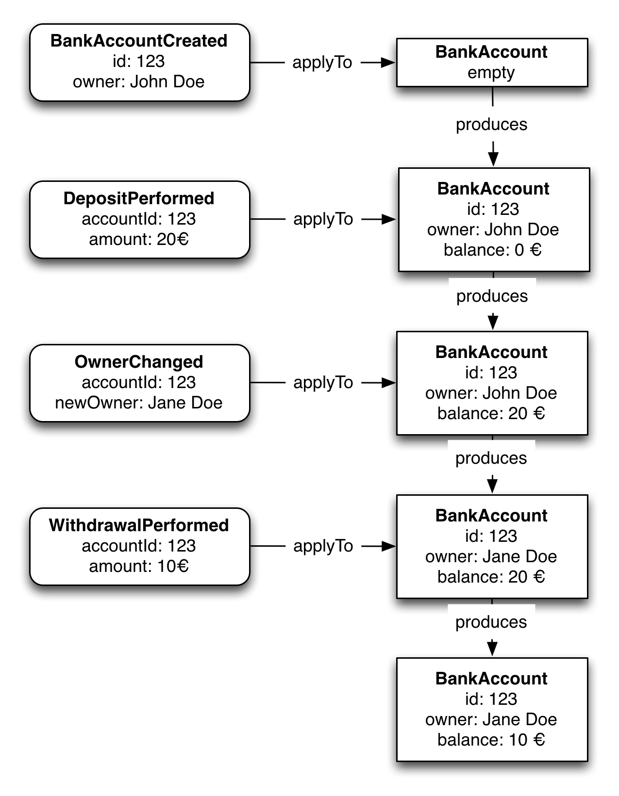
Event Sourcing

Slide 26
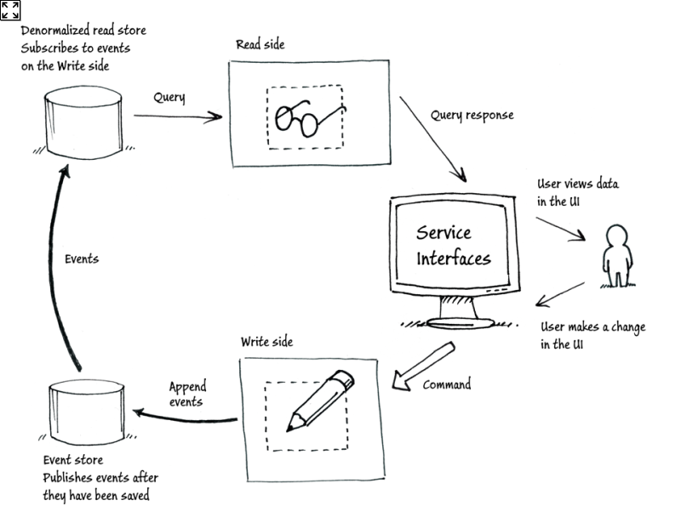
Event Sourcing (CQRS)

Slide 27
Blockchain
Blockchain BASED on Event Sourcing

Slide 28
Transaction-Log
Transaction-Log is doing Event Sourcing

Slide 29
Domain Driven Design
Data model is a 1:1 representation of business process
Terms will be taken from business process
Developers and business department are speaking the same language and using the same terms

Slide 30
Domain Driven Event Sourcing
Events are defined with an easy and plain language
Business process is described by events
Data is assignable from event
Data is stored the same way we store data in our lives
Comprehensibility of all data
Exported stream are easily understandable and simple to read within the same domain

Slide 31
Domain Driven Event Sourcing & GDPR
Transparent information
Concise => Events
Transparent => Stream of events
intelligible => Eventname
easily accessible form => stored like in real life
using clear and plain language => Domain terms
Right to data portability
Eventstreams exportable
Import by creating customized state machine (projection)

Slide 32
Domain Driven Event Sourcing
Challanges to solve:
Transparent information
Right to data portability
Right to erasure

Slide 33
Crypto-Shredding
Erasure data by storing it encrypted and then deleting/overwriting the encryption-key
Data unreadable if key was created securley
TPM and HSM support
iOS is doing crypto shredding

Slide 34
Crypto-Shredding
Challanges to solve:
Transparent information
Right to data portability
Right to erasure

Slide 35
Domain Driven Crypto Event Sourcing
Personal data (values) in events will be encrypted
Decrypt after current state has been created by state machine
Even after deleting key business relevant data still available for Reports etc.
Keys can be invalidated / expire at a on a specific date
Keyexchange every month/year easy to implement
Eligible for Blockchain use, because blocks are not changed once accepted / added to chain

Slide 36
Domain Driven Crypto Event Sourcing
Key can be broken / leaked
Recreate Eventstream with new Key
Delete old stream
Documents can be recreated from eventstream without breaking the integrity of documents
Data portablility
Keys need to be exported
Stream is recreted with key espacailly created for export
Events are stored as json

Slide 37
Domain Driven Crypto Event Sourcing
Challanges to solve:
Transparent information
Right to data portability
Right to erasure

Slide 38
Domain Driven Crypto Event Sourcing – getting started
Find out personal data that needs to be encrypted
Domain modelling
When to encrypt/decrypt
Which business events are on your domain
Which current states are needed (can be determined later)
Keymanagement
How to store keys
How to use stored keys
Event Store*

Slide 39
Domain Driven Crypto Event Sourcing – Migrate legacy systems
EventSourcing-systems
Copy stream and encrypt personal data
Blockchain
Recreate chain from legacy chain and encrypt personal data
Add key/encryption to smart contract
Full transaction-log available
Move log to EventSourced-system
Create new transaction-log

Slide 40
Domain Driven Crypto Event Sourcing – Migrate legacy systems
Non EventSourcing-based systeme
Port to an DDCEventSourced-system
Tranperant information for legacy data not available
Encrypt data in current system
Introduce auditing (if not done yet)
Define new data format for portability

Slide 41
Even better!
Hand out key
Before deleting the key, we can give the key to the customer
More trust: customer can examine exported data (tools needed)
If customer changes mind and wants to be a customer he just has to provide the key
Personal data is readable again

Slide 42
Even much better!
Gravatar like service for key management
Service is not providing keys
Instead: data will be sent to service for en/decryption
Better performance by using asym keys
Better security by spatial separation of key and data
Customer can see history of when did who encrypt/decrypt
Customer has control over right of erasure
When hacked, customer‘s personal data not readable
With well planned architecture, decryption of data can be done on client-side (front-end)

Slide 43
CLOUD-Act
Bad for customer trust:
Data disclosure to law enforcement (including foreign governments)
Disclosure to person of interest can be prohibited by law enforcement*

Slide 44
CLOUD-Act
Gravatar like service who resides in the EU
Higher effort for law enforcement
Data can be disclosed to law enforcement, because they are not readable without a key
Keys are not discloseable / exportable because they live in TPM/HSM
Disclosure prohibition may not be an issue, since data not readable*
When hacked,
Key not useable
Data not readable
Safely use of public Cloud providers (Azure, AWS, Google Cloud)

Slide 45
CLOUD-Act
Bad for customer trust:
Data disclosure to law enforcement (including foreign governments)
Disclosure to person of interest can be prohibited by law enforcement*

Slide 46

Thank you!

Slide 47
Resources
Github: https://twitter.com/dersia_
Slides: https://github.com/dersia/presentations

